Slide 1
Natural Language Processing
Prof.Vijayalakshmi
BITS-Pilani

Slide 2
These slides are prepared by the instructor, with grateful acknowledgement of James Allen and many others who made their course materials freely available online.

Slide 3
:POS tagging
What is Part of speech tagging
Why POS tagging is required
Application
(Mostly) English Word Classes
Tag set
Penn tree bank
Part-of-Speech Tagging
Different approaches
Rule based
Stochastic based
HMM Part-of-Speech Tagging
Hybrid system

Slide 4
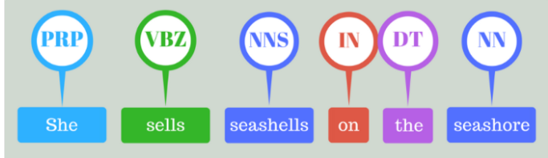
What is POS Tagging
The process of assigning a part-of-speech or lexical class marker to each word in a sentence (and all sentences in a collection).

Slide 5
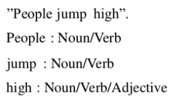

Process
List of all possible tag for each word in sentence
Eg:
Choose best suitable tag sequence

Slide 6
Why POS?
First step in many applications
POS tell us a lot about word
Pronunciation depends on POS
To find named entities
Stemming

Slide 7
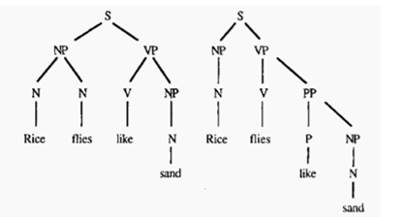
Application of POS
Parsing
Recovering syntactic structures requires correct POS tags
Eg:

Slide 8
Information retrieval
Word Disambiguation
-ability to determine which meaning of word is activated by the use of word in a particular context.
Eg:
I can hear bass sound.
He likes to eat grilled bass.

Slide 9
Question answering system
automatically answer questions posed by humans in a natural language.
Eg: Does he eat bass?

Slide 10
Why POS tagging is hard?
Ambiguity
Eg:
He will race/VB the car.
When will the race/NOUN end?
The boat floated/VBD … down the river sank
Average of ~2 parts of speech for each word

Slide 11
Parts of Speech
8 (ish) traditional parts of speech
Noun, verb, adjective, preposition, adverb, article, interjection, pronoun, conjunction, etc
Called: parts-of-speech, lexical categories, word classes, morphological classes, lexical tags...
Lots of debate within linguistics about the number, nature, and universality of these
We’ll completely ignore this debate.

Slide 12
POS examples
N noun chair, bandwidth, pacing
V verb study, debate, munch
ADJ adjective purple, tall, ridiculous
ADV adverb unfortunately, slowly
P preposition of, by, to
PRO pronoun I, me, mine
DET determiner the, a, that, those

Slide 13
POS Tagging
Assigning label to something or someone
The process of assigning a part-of-speech to each word in a collection.
WORD tag
the DET
koala N
put V
the DET
keys N
on P
the DET
table N

Slide 14
Open and Closed Classes
Open class: new ones can be created all the time
English has 4: Nouns, Verbs, Adjectives, Adverbs
Many languages have these 4, but not all!
Closed class: a small fixed membership
Prepositions: of, in, by, …
Auxiliaries: may, can, will had, been, …
Pronouns: I, you, she, mine, his, them, …
Usually function words (short common words which play a role in grammar)

Slide 15
Closed Class Words
Examples:
prepositions: on, under, over, …
particles: up, down, on, off, …
determiners: a, an, the, …
pronouns: she, who, I, ..
conjunctions: and, but, or, …
auxiliary verbs: can, may should, …
numerals: one, two, three, third, …

Slide 16
Tagsets
A set of all POS tags used in a corpus is called a tag set
There are various standard tag sets to choose from; some have a lot more tags than others
The choice of tagset is based on the application
Accurate tagging can be done with even large tag sets

Slide 17
Penn tree bank
Background
From the early 90s
Developed at the University of Pennsylvania
(Marcus,Santorinin and Marcinkiewicz 1993)
Size
40000 training sentences
2400 test sentences
Genre
Mostly wall street journal news stories and some spoken conversations
Importance
Helped launch modern automatic parsing methods.

Slide 18
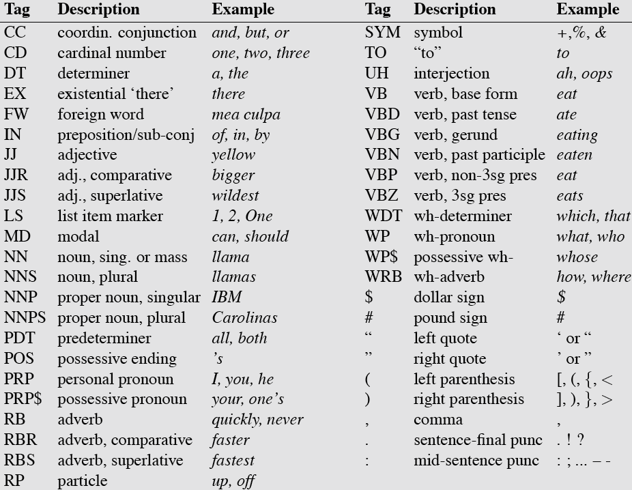
Penn TreeBank POS Tagset

Slide 19
Just for Fun…
Using Penn Treebank tags, tag the following sentence from the Brown Corpus:
The grand jury commented on a number of other topics.

Slide 20
Just for Fun…
Using Penn Treebank tags, tag the following sentence from the Brown Corpus:
The/DT grand/JJ jury/NN commented/VBD on/IN a/DT number/NN of/IN other/JJ topics/NNS ./.

Slide 21
POS Tagging- Choosing a Tag set
There are so many parts of speech, potential distinctions we can draw
To do POS tagging, we need to choose a standard set of tags to work with
Could pick very coarse tagsets
N, V, Adj, Adv.
More commonly used set is finer grained, the “Penn TreeBank tagset”, 45 tags
PRP$, WRB, WP$, VBG

Slide 22
Approaches to POS Tagging
Rule-based Approach
Uses handcrafted sets of rules to tag input sentences
Statistical approaches
Use training corpus to compute probability of a tag in a context-HMM tagger
Hybrid systems (e.g. Brill’s transformation-based learning)

Slide 23
Rule based POS tagging
First stage − In the first stage, it uses a dictionary to assign each word a list of potential parts-of-speech.
Second stage − In the second stage, it uses large lists of hand-written disambiguation rules to sort down the list to a single part-of-speech for each word.

Slide 24
Hidden Markov model

Slide 25
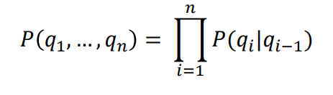
Markov model /Markov chain
A Markov process is a process that generates a sequence of outcomes in such a way that the probability of the next outcome depends only on the current outcome and not on what happened earlier.

Slide 26
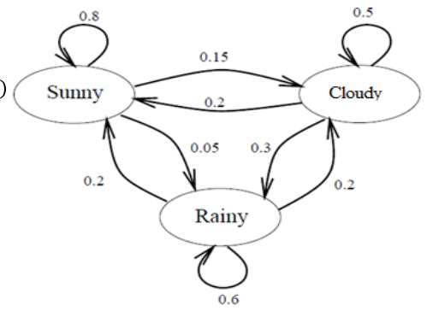
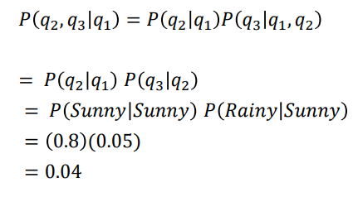
Example
Given that today is Sunny, what’s the probability that tomorrow is Sunny and the next day Rainy?

Slide 27
WHAT IS A HIDDEN MARKOV MODEL (HMM)?
A Hidden Markov Model, is a stochastic model where the states of the model are hidden. Each state can emit an output which is observed.
Imagine: You were locked in a room for several days and you were asked about the weather outside. The only piece of evidence you have is whether the person who comes into the room bringing your daily meal is carrying an umbrella or not.
What is hidden? Sunny, Rainy, Cloudy
What can you observe? Umbrella or Not

Slide 28
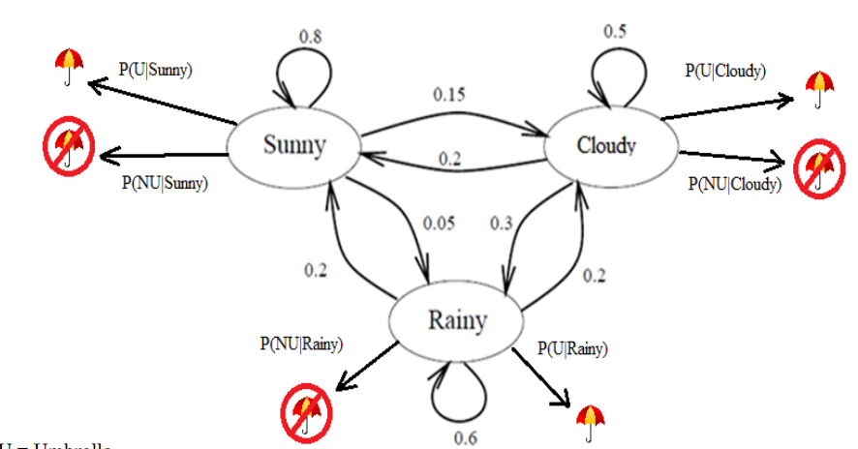
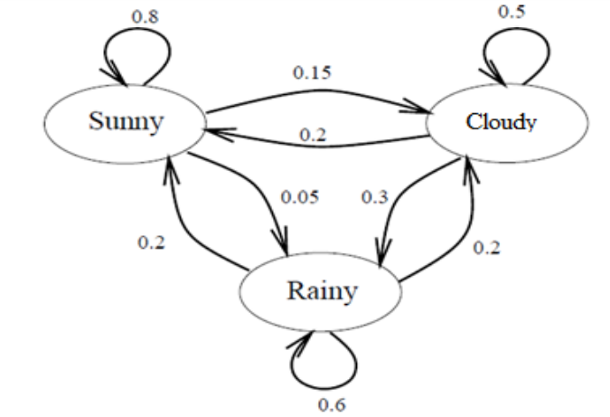
Markov chain Vs HMM
Markov chain
HMM

Slide 29
Hidden Markov Models (Formal)
States Q = q₁, q₂…q_{N;}
Observations O= o₁, o₂…o_{N;}
Transition probabilities
Transition probability matrix A = {a_{ij}}
Emission Probability /Output probability
Output probability matrix B={b_{i}(k)}
Special initial probability vector π

Slide 30
First-Order HMM Assumptions
Markov assumption: probability of a state depends only on the state that precedes it

Slide 31
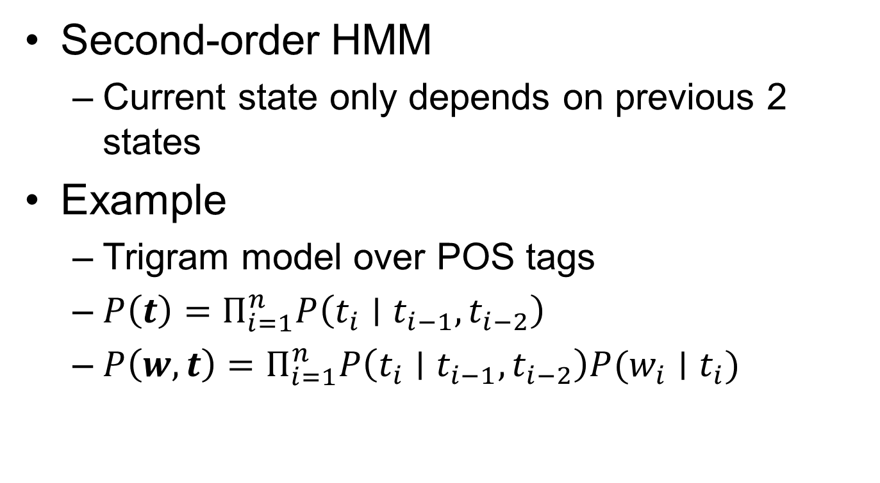
How to build a second-order HMM?
Second-order HMM
Current state only depends on previous 2 states
Example
Trigram model over POS tags
$P\left(t\right)=Π_{i=1}^{n}P\left(t_{i}∣t_{i−1},t_{i−2}\right)$
$P\left(w, t\right)=Π_{i=1}^{n}P\left(t_{i}∣t_{i−1},t_{i−2}\right)P(w_{i}∣t_{i})$

Slide 32
POS Tagging as Sequence Classification
We are given a sentence (an “observation” or “sequence of observations”)
Secretariat is expected to race tomorrow
What is the best sequence of tags that corresponds to this sequence of observations?
Probabilistic view
Consider all possible sequences of tags
Out of this universe of sequences, choose the tag sequence which is most probable given the observation sequence of n words w₁…w_{n}.

Slide 33
Probabilistic Sequence Models
Probabilistic sequence models allow integrating uncertainty over multiple, interdependent classifications and collectively determine the most likely global assignment.
standard model
Hidden Markov Model (HMM)

Slide 34
How you predict the tags?
Two types of information are useful
Relations between words and tags
Relations between tags and tags
DT NN, DT JJ NN…

Slide 35

Statistical POS Tagging
We want, out of all sequences of n tags t₁…t_{n} the single tag sequence such that
P(t₁…t_{n}|w₁…w_{n}) is highest.
Hat ^ means “our estimate of the best one”
Argmax_{x} f(x) means “the x such that f(x) is maximized”

Slide 36
Statistical POS Tagging
This equation should give us the best tag sequence
But how to make it operational? How to compute this value?
Intuition of Bayesian inference:
Use Bayes rule to transform this equation into a set of probabilities that are easier to compute (and give the right answer)

Slide 37
Using Bayes Rule
= PROB(T₁,…T_{n} | w₁,…w_{n})
Estimating the above takes far too much data. Need to do some reasonable approximations.
Bayes Rule:
PROB(A | B) = PROB(B | A) * PROB(A) / PROB(B)
Rewriting:
PROB(w₁,…w_{n} | T₁,…T_{n}) * PROB(T₁,…T_{n}) / PROB(w₁,…w_{n})

Slide 38
Contd..
=PROB(w₁,…w_{n} | T₁,…T_{n}) * PROB(T₁,…T_{n}) / PROB(w₁,…w_{n})
=PROB(w₁,…w_{n} | T₁,…T_{n}) * PROB(T₁,…T_{n})

Slide 39
Independent assumptions
So, we want to find the sequence of tags that maximizes
PROB(T₁,…T_{n}) * PROB(w₁,…w_{n} | T₁,…T_{n})
For Tags – use bigram probabilities
PROB(T₁,…T_{n}) ≈ π_{i=1,n} PROB(T_{i} | T_{i-1})
PROB(ART N V N) ≈ PROB(ART | Φ) * PROB(N | ART) * PROB(V | N) * PROB(N | V)
For second probability: assume word tag is independent of words around it:
PROB(w₁,…w_{n} | T₁,…T_{n}) ≈ π_{i=1,n} PROB(w_{i} | T_{i})

Slide 40
POS formula
Find the sequence of tags that maximizes:
π_{i=1,n} PROB(T_{i} | T_{i-1}) * PROB(w_{i} | T_{i})

Slide 41
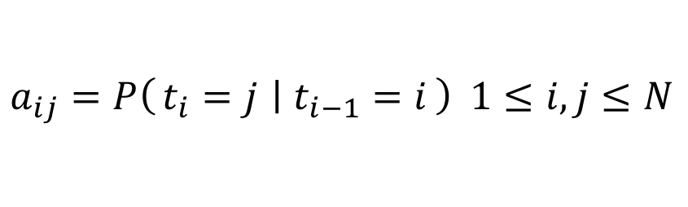


POS Tagging using HMM
States T = t₁, t₂…t_{N;}
Observations W= w₁, w₂…w_{N;}
Each observation is a symbol from a vocabulary V = {v₁,v₂,…v_{V}}
Transition probabilities
Transition probability matrix A = {a_{ij}}
Observation likelihoods
Output probability matrix B={b_{i}(k)}
Special initial probability vector π
$$a_{ij}=P\left(t_{i}=j ∣ t_{i−1}=i\right) 1≤i,j≤N$$
$$b_{i}(k)=P\left(w_{i}=v_{k} ∣ t_{i}=i\right)$$
$$π_{i}=P\left(t_{1}=i\right) ≤i≤N$$

Slide 42
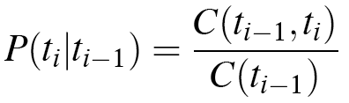
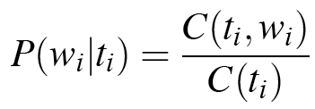
Two Kinds of Probabilities
State transition probabilities -- p(t_{i}|t_{i-1})
State-to-state transition probabilities
Observation/Emission probabilities -- p(w_{i}|t_{i})
Probabilities of observing various values at a given state

Slide 43
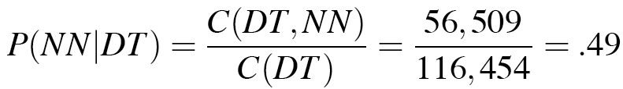
Two Kinds of Probabilities
Tag transition probabilities -- p(t_{i}|t_{i-1})
Determiners likely to precede adjs and nouns
That/DT flight/NN
The/DT yellow/JJ hat/NN
So we expect P(NN|DT) and P(JJ|DT) to be high
Compute P(NN|DT) by counting in a labeled corpus:

Slide 44
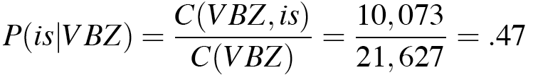
Two Kinds of Probabilities
Word likelihood/emission probabilities p(w_{i}|t_{i})
VBZ (3sg Pres Verb) likely to be “is”
Compute P(is|VBZ) by counting in a labeled corpus:

Slide 45
Sample Probabilities
Bigram Probabilities
Bigram(Ti, Tj) Count(i, i + 1) Prob(Tj|Ti)
φ,ART 213 .71 (213/300)
φ,N 87 .29 (87/300)
φ,V 10 .03 (10/300)
ART,N 633 1
N,V 358 .32
N,N 108 .10
N,P 366 .33
V,N 134 .37
V,P 150 .42
V,ART 194 .54
P,ART 226 .62
P,N 140 .38
V,V 30 .08
Tag Frequencies
Φ ART N V P
300 633 1102 358 366

Slide 46
Sample Lexical Generation Probabilities
P(an | ART) .36
P(an | N) .001
P(flies | N) .025
P(flies | V) .076
P(time | N) .063
P(time | V) .012
P(arrow | N) .076
P(like | N) .012
P(like | V) .10
P(like | P) .068
Note: the probabilities for a given tag don’t add up to 1, so this table must not be complete. These are just sample values

Slide 47
Two types of stochastic POS tagging
Word frequency tagging
based on the probability that a word occurs with a particular tag.
Tag sequence probabilities
calculates the probability of a given sequence of tags occurring.
53

Slide 48
Example1-Some Data on race
Secretariat/NNP is/VBZ expected/VBN to/TO race/VB tomorrow/NR
People/NNS continue/VB to/TO inquire/VB the/DT reason/NN for/IN the/DT race/NN for/IN outer/JJ space/NN
How do we pick the right tag for race in new data?
11/30/2025
48
Notes:
48

Slide 49
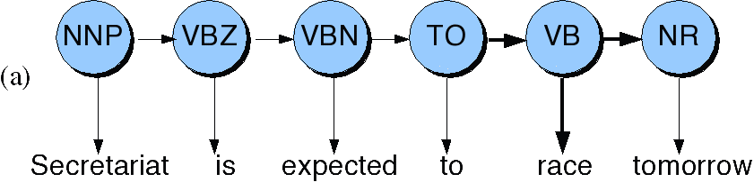
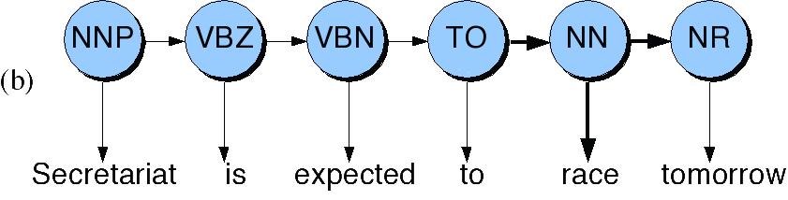
Disambiguating to race tomorrow
11/30/2025
49
Notes:
49

Slide 50
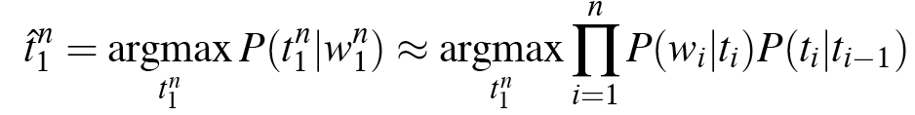
Look Up the Probabilities
11/30/2025
50
P(NN|TO) = .00047
P(VB|TO) = .83
P(race|NN) = .00057
P(race|VB) = .00012
P(NR|VB) = .0027
P(NR|NN) = .0012
P(VB|TO)P(NR|VB)P(race|VB) = .00000027
P(NN|TO)P(NR|NN)P(race|NN)=.00000000032
So we (correctly) choose the verb reading
Notes:
50
Note that all the probabilities will be the same except for the tag sequences around ‘race’ and the tags for ‘race’ so we exclude all of those from the calculation to get the difference

Slide 51
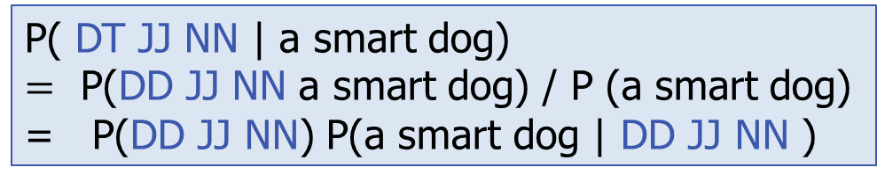
Example2:Statistical POS tagging-Whole tag sequence
What is the most likely sequence of tags for the given sequence of words w
P( DT JJ NN | a smart dog)
$=$ P(DD JJ NN a smart dog) / P (a smart dog)
= P(DD JJ NN) P(a smart dog | DD JJ NN )

Slide 52
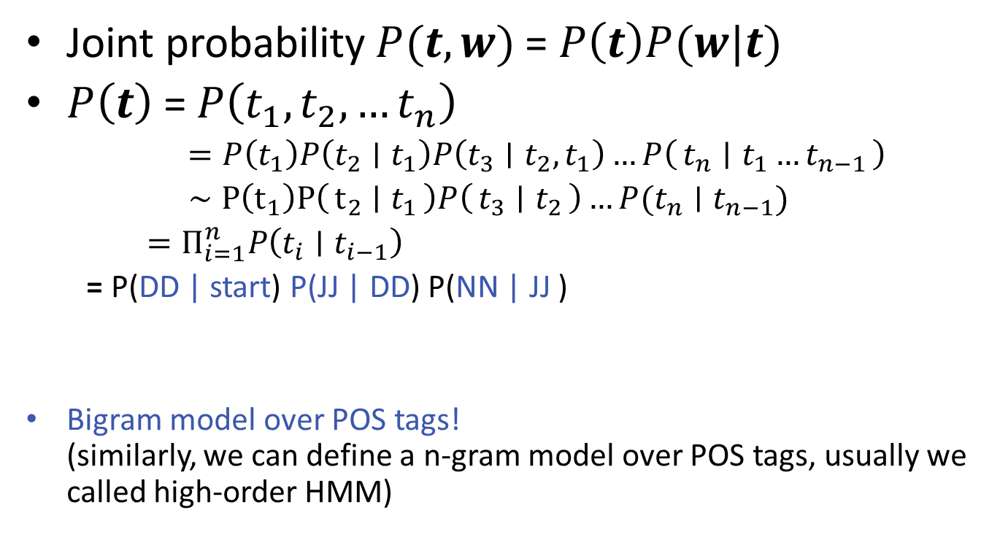
Tag Transition Probability
Joint probability $P(t,w)$ = $P\left(t\right)P(w|t)$
$P\left(t\right)$ = $P\left(t_{1},t_{2},…t_{n}\right)$
$=P\left(t_{1}\right)P\left(t_{2}∣t_{1}\right)P\left(t_{3}∣t_{2},t_{1}\right)…P\left(t_{n} ∣ t_{1}…t_{n−1}\right)$
$∼P\left(t_{1}\right)P\left(t_{2} ∣ t_{1}\right)P\left(t_{3} ∣ t_{2}\right)…P(t_{n}∣t_{n−1})$
$=Π_{i=1}^{n}P\left(t_{i}∣t_{i−1}\right)$
= P(DD | start) P(JJ | DD) P(NN | JJ )
Bigram model over POS tags! (similarly, we can define a n-gram model over POS tags, usually we called high-order HMM)
Markov assumption

Slide 53
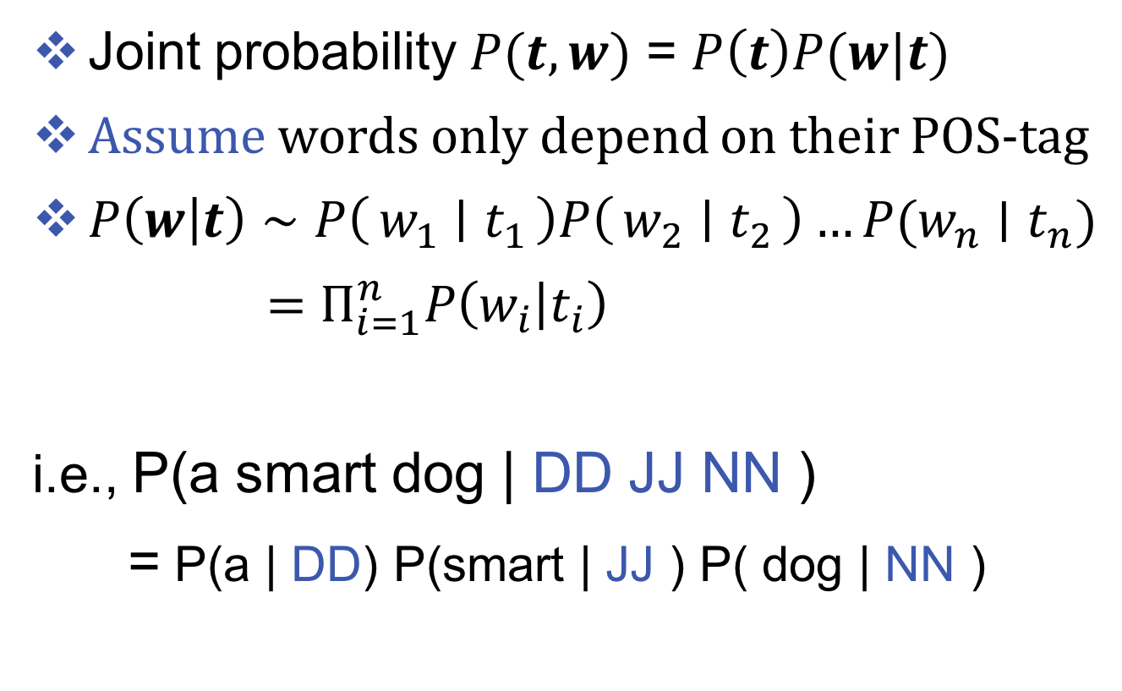
Word likelihood /Emission Probability
Joint probability $P(t,w)$ = $P\left(t\right)P(w|t)$
Assume words only depend on their POS-tag
$P\left(w | t\right)∼P\left(w_{1} ∣ t_{1}\right)P\left(w_{2} ∣ t_{2}\right)…P(w_{n}∣t_{n})$
$=Π_{i=1}^{n}P\left(w_{i} | t_{i}\right)$
i.e., P(a smart dog | DD JJ NN )
= P(a | DD) P(smart | JJ ) P( dog | NN )
Independent assumption

Slide 54
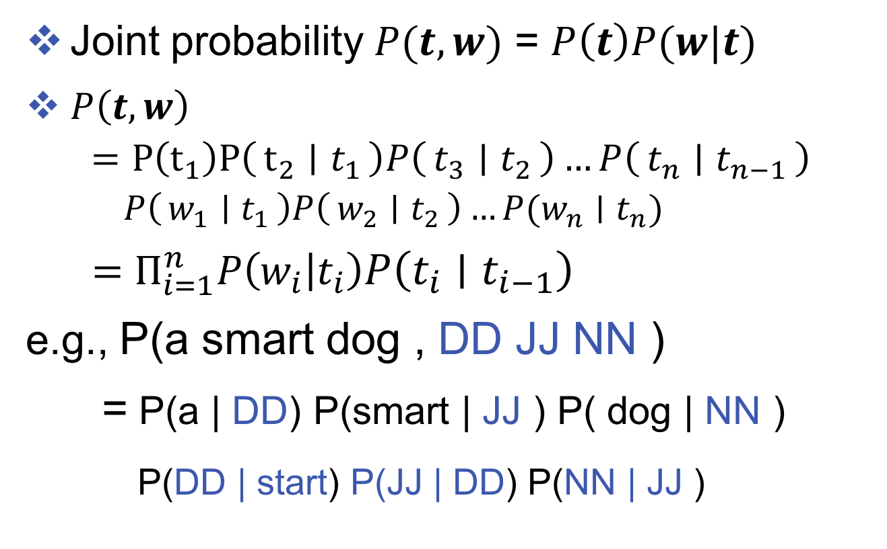
Put them together
Joint probability $P(t,w)$ = $P\left(t\right)P(w|t)$
$P\left(t,w\right)$
$$=P\left(t_{1}\right)P\left(t_{2} ∣ t_{1}\right)P\left(t_{3} ∣ t_{2}\right)…P\left(t_{n} ∣ t_{n−1}\right) \\ P\left(w_{1} ∣ t_{1}\right)P\left(w_{2} ∣ t_{2}\right)…P(w_{n}∣t_{n})$$
$=Π_{i=1}^{n}P\left(w_{i} | t_{i}\right)P\left(t_{i}∣t_{i−1}\right)$
e.g., P(a smart dog , DD JJ NN )
= P(a | DD) P(smart | JJ ) P( dog | NN )
P(DD | start) P(JJ | DD) P(NN | JJ )

Slide 55

Put them together
Two independent assumptions
Approximate P(t) by a bi(or N)-gram model
Assume each word depends only on its POStag
initial probability
$$p(t_{1})$$

Slide 56
Example1-HMM
Will can spot Mary
M V N N
Will Can spot Mary
N M V N

Slide 57
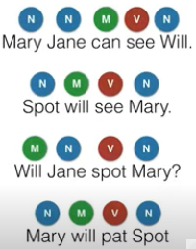
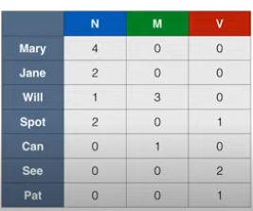
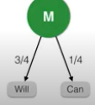
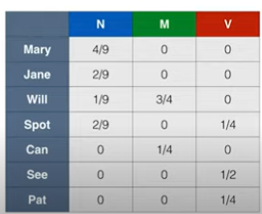
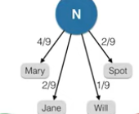
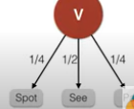
Emission probabilities

Slide 58
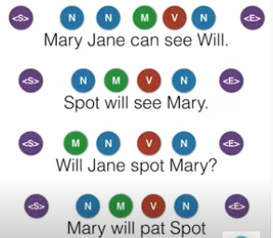
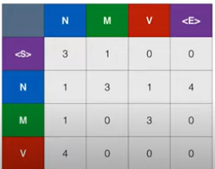
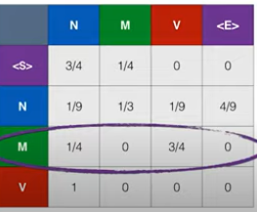
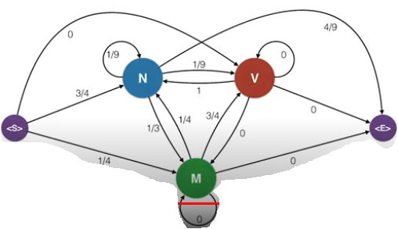
Transition probabilities

Slide 59
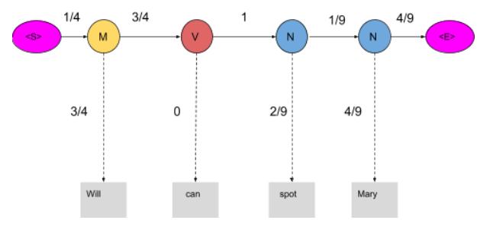
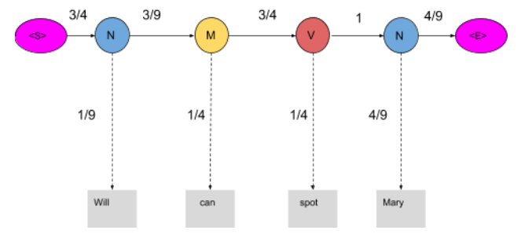


Correct sentence is Will/N can/M Spot/V Mary /N

Slide 60
Thank You… ☺
Q&A
Suggestions / Feedback

